Slide 1
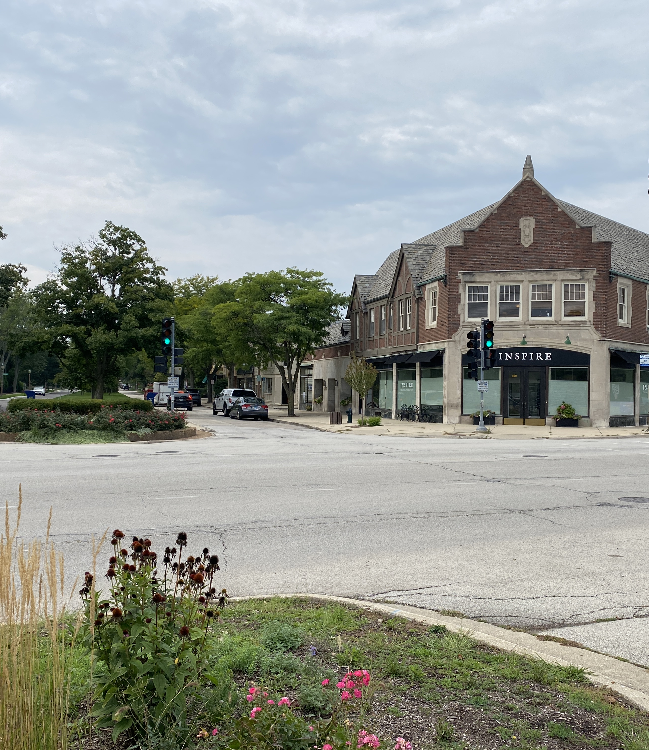
Green Bay Road Corridor and Streetscape Improvements
Village of Kenilworth
January 26, 2026
Village Board

Slide 2
Agenda
Project Background
Planning Efforts
Implemented Improvements
Phase I Engineering
Steps Forward and Direction

Slide 3
Project Background
Nearly 20 years of Corridor planning
Focus on safety, parking, and economic vitality

Slide 4
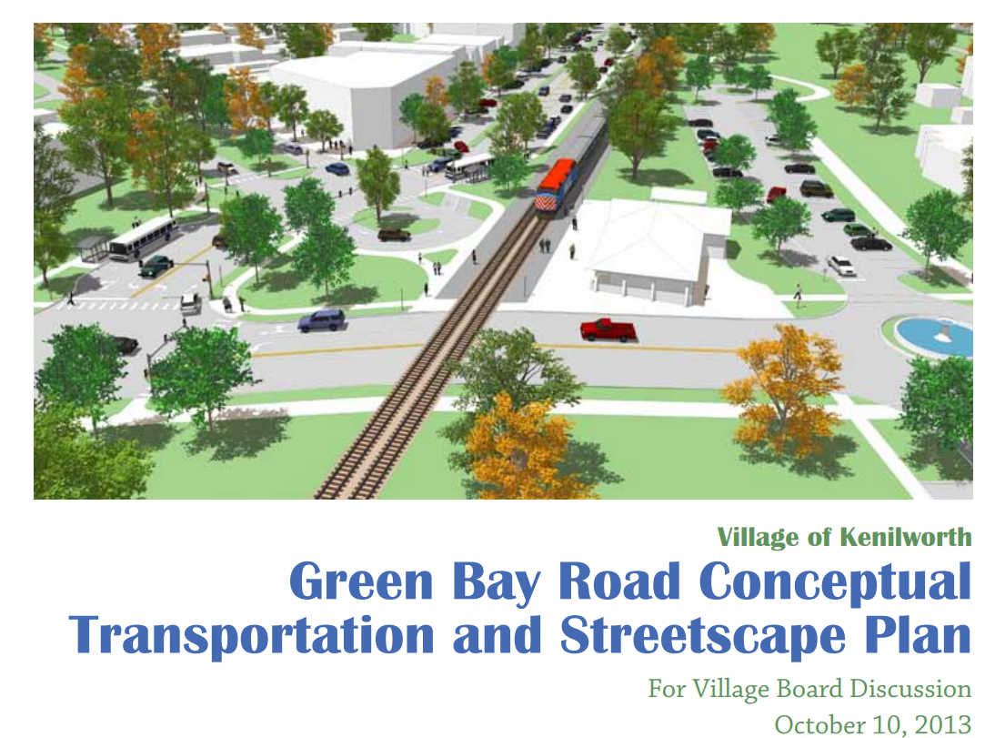
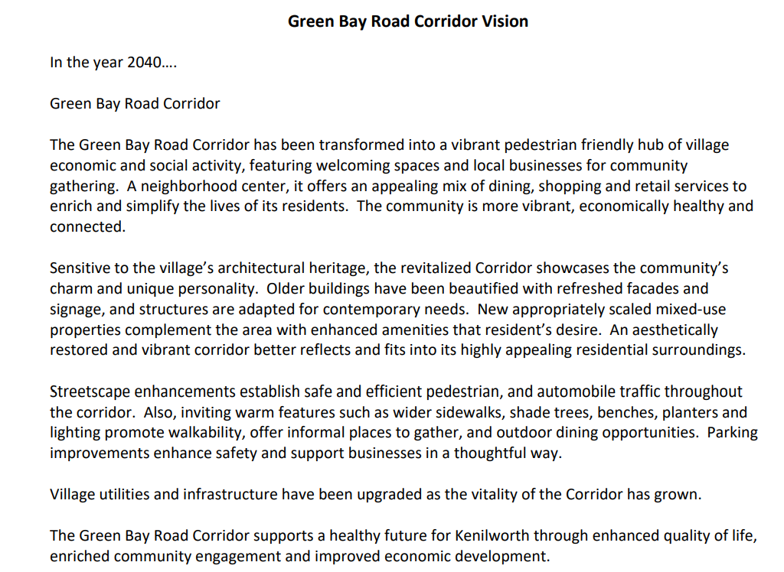
Planning Efforts
2008 Comprehensive Plan
2013
Streetscape Plan
2021
Visioning Process
2023–2024 Enhancement Study (Conceptual Design)
2026 Phase I Engineering (Pending)
Notes:
The Village has many tools in the toolbox that direct planning generally on the Green Bay Road Corridor. There has been many planning efforts that have guided certain actions.
First and foremost, The Village's Comprehensive Plan was adopted on January 14, 2008, and establishes goals, and objectives for land-use, transportation, and community facilities, for the future development of the Village.
In 2012, an analysis of the Green Bay Road corridor mobility was conducted. The analysis was led by the Plan Commission and included representatives from Sears School, the Park District, PACE, METRA, Union Pacific, and IDOT, with consulting support from Houseal Lavigne (planning), Gewalt Hamilton (traffic engineering), Active Transportation Alliance (transit specialists), and Altamanu (urban planning). As a result of the study, the Green Bay Road Conceptual Transportation and Streetscape plan was delivered in October 2013. In the 10 years since the report was delivered, several of the recommended changes have been implemented, including the relocation of Sterling Road and the reconfiguration of the Richmond/Kenilworth intersection near the train station.
In 2022, the Village completed the re-visioning process for the Green Bay Road business corridor. The process included focus group meetings, public forums, as well as stakeholder surveys. During the visioning process, several commenters raised concerns related to traffic speed and pedestrian safety along Green Bay Road. Given these concerns, in addition to the renewed interest in the business district and desire to create a pedestrian-friendly area, a review of the configuration of Green Bay Road within the business district was identified as a primary goal of the Village Board in 2023.
In 2023, the villages of Kenilworth and Winnetka entered into a joint agreement with Ciorba Group to initiate a conceptual study of Green Bay Road between Kenilworth Avenue and Winnetka Road. The purpose of the study is to explore the feasibility and desirability of roadway reconfiguration concepts and identify streetscape enhancements. Over the past year, staff from both communities have been working with Ciorba to develop potential concepts to share with residents. In 2024, several open houses were held to gather public input on potential streetscape and alignment concepts for Green Bay Road. Ciorba is utilizing that feedback to further refine the concepts.

Slide 5
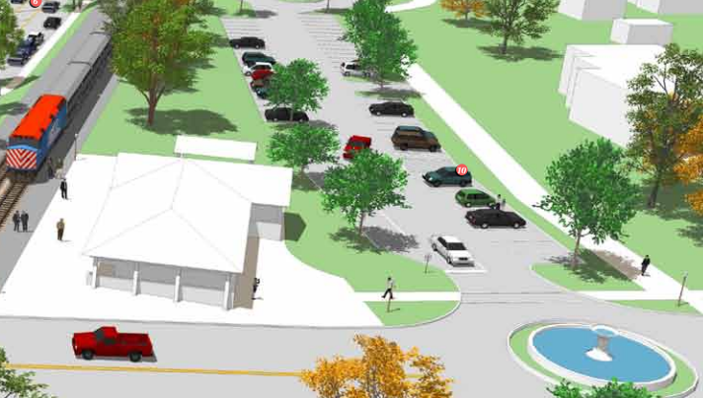
Implemented Improvements
Sterling Road Realignment (2019)
Richmond Road Parking (2020)
Pedestrian Safety Improvements (2021-2022)
604 Green Bay Development Opp.
Variety of Code Amendments
Planters (2024-)
Façade Grant Improvement Program (2024-)
Notes:
Several of the recommended changes have since been implemented:
Reconfigured parking on Richmond Road, east of the Metra station;
Realigned Sterling Road intersection;
New development opportunity at 604 Green Bay Road; and
Shortened pedestrian crossing at Kenilworth Avenue / Richmond Road intersection.

Slide 6
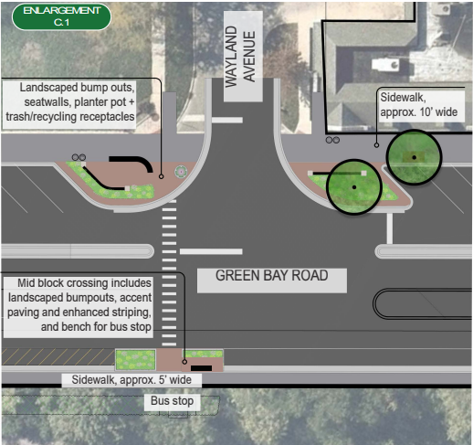
Project Goals
Revitalize Business District
Improve Safety for All Users
Enhance Walkability
Increase Parking
Beautify corridor
Create gathering spaces
Notes:
To further define the Goals:
Improved safety may include reduced lanes (road diet), slowed traffic, additional crosswalks.
Improved walkability by creating wider sidewalks and additional crosswalks.
Increased parking with diagonal configuration, also exploring shared parking arrangements such as use of adjacent parking lots.
Beautification of the corridor but creating landscaped bump-outs, planting more trees.
Places to gather to create community such adding wider sidewalks for outdoor dining.

Slide 7
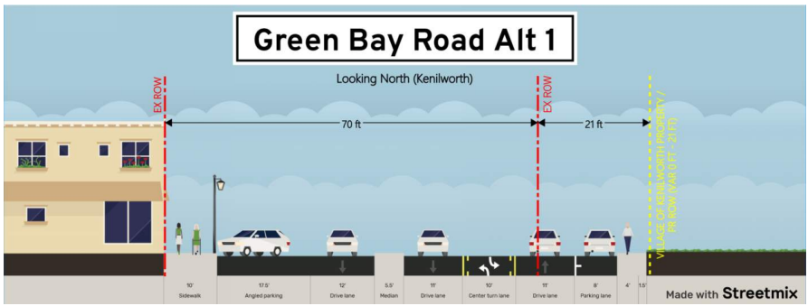
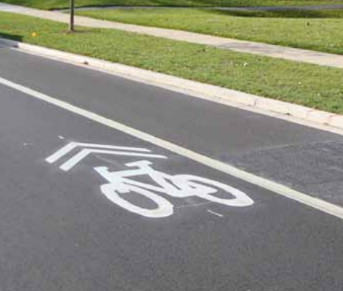
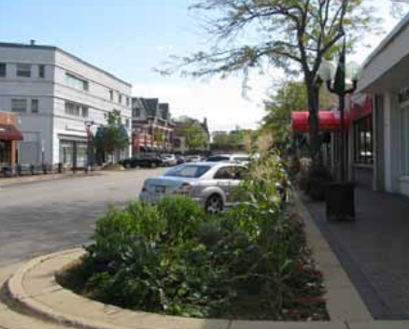
Enhancement Concepts
Lane reduction
Wider sidewalks
Diagonal or parallel parking
Streetscape Enhancements
Notes:
During Phase I, several concepts will be explored in addition to the ones proposed in the conceptual design.
Maintain parallel parking on both sides to be able to provide a wider sidewalk. The landscaped bump outs and mid-block crosswalks would need to be reviewed in terms of parking.
Maintain parallel parking on both sides plus add bike lanes. This would help with additional funding alternatives especially when it addresses connectivity with other bike facilities. This would help with the purpose and need statement for the Phase I. This would impact the amount of additional sidewalk
Diagonal parking, but without the separation between the through lanes of Green Bay Roa, we have provided a few examples in your packet. This would alleviate the concerns about navigating between the parking area and the through movements.

Slide 8

Phase I Engineering Study Overview
Engineering analysis
Concept alternatives
Traffic & safety review
Public Engagement

Slide 9
Schedule & Costs – Phase I
IDOT PROJECT PHASES
PHASE 1 | Preliminary engineering + environmental studies Project scope
PHASE 2 | Contract plan prep Local agency agreements Land acquisition
PHASE 3 | Construction
18–24 months
Estimated cost: $375k–$400k
Split across FY26–FY27
Notes:
Its important to know that projects like these are good candidates for grants.
The most recent example was the resurfacing of Kenilworth Avenue between Sheridan and Green Bay Road. The Village was selected to receive Surface Transportation Program (STP) funding for the project, which had a 70/30 federal-local cost-share, offsetting a significant portion of the cost of the project.

Slide 10
Next Steps
Consensus to proceed with
Phase I Study
Retain Ciorba Group

